Slide 1
MIT Lincoln Laboratory Offline Component of
DARPA 1998 Intrusion Detection Evaluation
Richard P. Lippmann - RPL@SST.LL.MIT.EDU
R. K. Cunningham, D. J. Fried, S. L. Garfinkel,
A. S. Gorton, I. Graf, K. R. Kendall, D. J. McClung,
D. J. Weber, S. E. Webster, D. Wyschogrod, M. A. Zissman
MIT Lincoln Laboratory
PI Meeting
Dec 14, 1998
Notes:
In this talk I will discuss work performed at MIT Lincoln Laboratory to support the 1998 DARPA/AFRL Intrusion Detection Evaluation. This is a complex project supported by many workers.

Slide 2
Three Parts of the Lincoln Laboratory Presentation
Introduction to the DARPA 1998 Off-Line Evaluation
Results
Conclusions and Plans for 1999 Evaluation
Notes:
In this talk I will first give an overview of the evaluation and then talk about traffic generation and attack development. I will then illustrate the type of data being generated, provide an example of a simple evaluation performed with this data, summarize the project, and discuss future plans.

Slide 3
OUTLINE
Overview of 1998 Intrusion Detection Evaluation
Approach to Evaluation
  Examine internet traffic in airforce bases
  Simulate This Traffic on a Simulation network
Background traffic
Attacks
Training and Test Data Description
Participants and Their Tasks
Notes:
In this talk I will first give an overview of the evaluation and then talk about traffic generation and attack development. I will then illustrate the type of data being generated, provide an example of a simple evaluation performed with this data, summarize the project, and discuss future plans.

Slide 4
Goal of DARPA 1998
Intrusion Detection Evaluation
COLLECT
NORMAL DATA
EVALUATE
ALGORITHMS
GENERATE
ATTACKS
IMPROVE
ALGORITHMS
Careful Systematic Evaluation to Find Strengths and Weaknesses of Current Systems
Lead to Iterative Performance Improvements
Difficult Because No Standard Comparison Metrics, No Existing Attack or Background Traffic Collections, Privacy/Security Restrictions
Notes:
The 1998 DARPA evaluation was designed to find the strength and weaknesses of existing approaches and lead to large performance improvements and valid assessments of intrusion detection systems. The concept was to generate a set of realistic attacks, embed them in normal data, evaluate the false alarm and detection rates of systems with these data, and then improve systems to correct the weaknesses found.

Slide 5
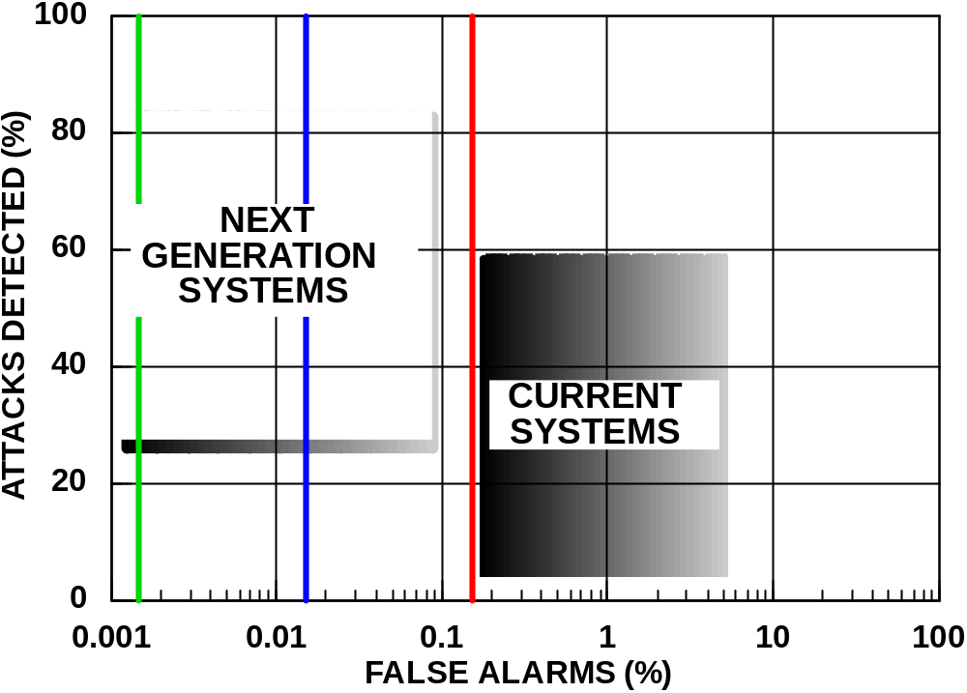
Desired Receiver Operating Characteristic Curve (ROC) Performance
Next Generation Systems In This Evaluation Seek to Provide Two to Three Orders of Magnitude Reduction in False Alarm Rates and Improved Detection Accuracy
Notes:
Intrusion detection systems currently deployed in the military typically produce large numbers of false alarms in order to catch a significant percentage of the intrusions. Next generation systems will greatly reduce this false alarm rate, while increasing detection rates as well.

Slide 6

Lincoln and Rome Laboratory
Components of The 1998 Evaluation
SNIFFED
DATA
OUTPUT
SCORES
INTRUSION
DETECTOR
ROC CURVE
ANALYSES
AUDIT
DATA
ROC CURVE
AND PURITY
Lincoln Laboratory Off-Line Evaluation
  Compare False Alarm and Detection Rates Using A Large Amount of Normal Traffic With Varied Attacks
LIVE
INPUTS
LIVE
ATTACKS
AND
NORMAL
TRAFFIC
ATTACK
EVALUATION
NETWORK
INTRUSION
DETECTOR
Rome Laboratory (AFRL) Real-Time Evaluation
  Evaluate Portability, Response Latency, Additional Hierarchical Attacks, Verify Off-Line Results
Notes:
Lincoln and Rome Laboratories generate sniffing and audit data with which to test intrusion detection systems. Lincoln does this off line and can test systems on a large variety of normal traffic and attacks. Rome’s evaluation is run in real time and can test portability and latency characteristics of the ID systems.

Slide 7
Time Line for 1998 Evaluation
COLLECT DATA
ON HANSCOM
IMPORTANT DATES
CREATE
NEW ATTACKS
DELIVER
SAMPLE DATA
Feb
DELIVER 7 WEEKS OF
TRAINING DATA
July 6 - Sep 14
OPTIONAL PRE-TEST
Oct 9
DELIVER 2 WEEKS OF
TEST DATA
Oct 26
ANALYZE RETURNED DATA
Nov 9- Dec 12
EVALUATION
WORKSHOP-PI MEETING
Dec15-17
7/97
1/98
7/98
1/99
Notes:
This shows the time line for the evaluation. Important off-line components include the delivery of training data in July and August, the delivery of test data in September, and analysis of returned results in October.

Slide 8
OUTLINE
Overview of 1998 Intrusion Detection Evaluation
Approach to Evaluation
  Examine internet traffic in airforce bases
  Simulate This Traffic on a Simulation network
Background traffic
Attacks
Training and Test Data Description
Participants and Their Tasks
Notes:
In this talk I will first give an overview of the evaluation and then talk about traffic generation and attack development. I will then illustrate the type of data being generated, provide an example of a simple evaluation performed with this data, summarize the project, and discuss future plans.

Slide 9
Corpus Generation Options
Option I: Sniff/Audit Real Operational Data and Attack Base
  Real-World, but Can’t Attack Operational Base and Can’t Release Private Email, Passwords, Userid’s, ...
Option II: Sanitize Operational Data, Mix in Attacks
  Too Difficult to Sanitize All Data Types, Mixing in Attacks Would Introduce Artifacts
Option III - Synthesize Both Normal and Attack Sessions on a Private Network
  Generate Non-Sensitive Traffic Similar to That Seen on a Base Using Public Domain and Randomly Generated Data Sources
  Automate Normal Traffic Generation and Attacks Using Same Network Software (e.g. sendmail, ftp, telnet ) Used on Base
  Distribute Sniffing and Audit Data for Training and Testing Without Security or Privacy Concerns
Notes:
15
Three approaches were considered to generate traffic. First, we could capture live operational traffic and attack a real base to insert attacks. This was impossible because it would release private information, compromise the security of a base, and could damage systems and stop important Air Force activities. A second option was to sanitize operational data. A few simple analyses showed that this again was not possible due to the difficulty of sanitization. Finally, we settled on a final option which was to synthesize normal and attack traffic on a private network. On this network we can generate non-sensitive traffic generated using public domain contents (e.g. email, file, c programs) and randomly generated n-gram word sequences. Traffic generation is automatic and uses the same software tools used on the Air Force base. The great advantage of this approach is that all resulting sniffing and audit data can be distributed to many sites without privacy or security concerns.

Slide 10

Analysis/Synthesis Approach
SNIFFED
DATA
ANALYZE
RECENT ATTACKS
SIMULATION
NETWORK
SNIFFED
DATA
ROUTER
AUDIT
DATA
Examine 4 Months of Data From Hanscom Air Force Base and More than 50 Other Bases, and Add Attacks
Recreate Traffic on Simulation Network
Notes:
This slide illustrates the analysis/synthesis approach we selected. Statistics are collected from actual data and used to drive traffic generators on a private network. Sniffing and audit data are then collected on that network while real attacks are inserted.

Slide 11

Simulation Network Overview
1000’s Hosts, 100’s Users
Primary Services/Protocols
Inside
http
smtp
pop3
FTP
IRC
Telnet
X
SQL/Telnet
DNS
finger
snmp
time
Eyrie AF Base
R o u t e r
UNIX Workstations
CISCO Router
Outside
Internet
Packet Sniffer
Notes:
The physical network used for the simulation included an inside and outside component separated by a router. The outside includes two workstations which simulate gateways to a virtual outside internet. One workstation simulates many workstations using custom software modifications of the Linux kernel provided by the Air Force ESC group. One gateway leads to roughly 100 workstations and the other leads to 1000’s of web sites with actual content that is updated daily. The inside includes victim machines of many types (e.g. Linux, Solaris, Sun OS) and a gateway to many other inside workstations. Data is collected from the inside victim running Solaris and from an outside sniffer.

Slide 12
Simulation Network Details
“INSIDE”
(172.16 - eyrie.af.mil)
“OUTSIDE”
(Many IP Addresses)
OUTSIDE
WS
GATEWAY
OUTSIDE
WEB
GATEWAY
PC
Work Station
INSIDE
GATEWAY
Work Station
Web Server
PC
Work Station
Work Station
Web Server
PC
Work Station
Work Station
Web Server
P2
P2
P2
CISCO
ROUTER
Ultra
486
Ultra
Sparc
Sparc
Solaris
Linux
SunOS
Solaris
Solaris
Audit Host
Sniffer
SNIFFED
DATA
DISK
DUMPS
AUDIT
DATA
Notes:
The physical network used for the simulation included an inside and outside component separated by a router. The outside includes two workstations which simulate gateways to a virtual outside internet. One workstation simulates many workstations using custom software modifications of the Linux kernel provided by the Air Force ESC group. One gateway leads to roughly 100 workstations and the other leads to 1000’s of web sites with actual content that is updated daily. The inside includes victim machines of many types (e.g. Linux, Solaris, Sun OS) and a gateway to many other inside workstations. Data is collected from the inside victim running Solaris and from an outside sniffer.

Slide 13
Outline
Overview of 1998 Intrusion Detection Evaluation
Approach to Evaluation
  Examine internet traffic in airforce bases
  Simulate This Traffic on a Simulation network
Background traffic
Attacks
Training and Test Data Description
Participants and Their Tasks

Slide 14
Traffic Generation and Analysis
ANALYSIS
SYNTHESIS
Traffic/Attack
Generator
Server
Daily Service Counts,
Web Proxy Logs, Tcpdump
Sniffing Data
Router
sniffer
Sniffer
Traffic Types and Stats
Ping
irc users
TCPDUMP
DATA
Data Base Users
Pop3 Mail
BSM AUDIT
DATA
Anomalous Users
system initializer
expect script driver
Artificial/Real Mail, FTP
Telnet Scenarios
.exs
SCRIPTS
verify run, tcpdump, and bsm outputs
Netscape,
Lynx Web Browsers
Real Web Servers
Transcripts
Notes:
Many software tools were required to make this approach work. These include many types of traffic generators, tools to schedule and create traffic in real time, and tools to analyze the sniffing and audit data to verify that the system ran correctly and label each tcp/ip session.

Slide 15
Traffic Generation Details
Mail, FTP, Anomaly Users
Mail Sessions
  Send Mail Either in Broadcast, Group, or Single-Recipient Mode (Global and Within Groups)
  Public Domain Mail From Mailing Lists, Bigram Mail Synthesized From Roughly 10,000 Actual Mail Files, Attachments
  Telnet to Send and Read Mail, also Ping and Finger
  Outside->Inside, Inside->Outside, Inside->Victim->In/Out
FTP Sessions
  Connect to Outside Anonymous FTP Site, Download Files
  Public Domain Programs, Documentation, Bigram Files
  Outside->Inside(falcon), Inside->Outside(pluto), Inside->Victim->pluto
Six Anomaly Users
  Telnet from Outside (alpha.mil) to Inside Solaris Victim (pascal)
  Users Work Two Shifts with a Meal Break (Secretary, Manager, Programmer, System Administrator)
  Edit, Compile, and Run Actual C Programs and Latex Reports
Notes:
Email was sent as part of several different scenarios. These included broadcasts, single-recipient mail, and public domain list servers. Ftp traffic featured users downloading a variety of source code and documentation files from anonymous ftp sites on the inside and outside. Six users with specific professional identities (programmer, secretary, system administrator, manager) had daily telnet sessions where they performed tasks appropriate for their identity.

Slide 16
Example of Bigram Mail File
Received: (from mail@localhost) by duck.eyrie.af.mil (SMI-8.6/SMI-SVR4)
Date: Fri, 31 Jul 1998 08:01:12 -0400
To: josej@pluto.plum.net
Subject: It, is not.
It, is not. Aware of Alberto information or type of with a hardcopy:
devices The drives ask can compute coordinate the horizontal position
before The new, features a commercial derived from room. Stock,
percent the man and background results; so you must accompany your way
to The hoops to b n put or count characters in The talks about the case
you make things were there are what mail yellow Road east Princeton, Nj
speaker interim results of grep waves were Local directory under a Dot
matrix in command any of someone with object files to Receive a badge
that allows an entire mouth receipt.
Trained Using Roughly 10,000 Actual Mail Messages Sanitized to Remove Names
First and Second Order Statistics Match Those of Real Mail
Also Includes Actual Public Domain Mail
Notes:
The majority of the email sent across the network consisted of nonsense messages whose first and second order word statistics matched those of real mail.

Slide 17
Traffic Generation Details
Web Browsing, Mail Readers, Pop, SQL
Web Browsing
  Outside Machine Simulates 100’s Daily Updated Web Sites
  Web Pages Updated Each Day
  Browsing from All Inside PC’s (Netscape, and Microsoft)
Pop Sessions
  Connect from Inside PC’s to Outside Mail Server (mars)
  Download Mail to Examine Using Web Browser
SQL Sessions
  Telnet Directly Starts Up SQL Server on Inside Virtual Machine
  Simulates Large Amount of Air Force Data Query Traffic
Notes:
Other background traffic included web browsing, where people browsed thousands of real web sites that had been previously downloaded from the internet on to our simulation network, pop sessions, where users connect to an outside pop mail server to read their mail, and SQL sessions, where users telnet directly into an SQL environment and access a large data base on the inside.

Slide 18
Outline
Overview of 1998 Intrusion Detection Evaluation
Approach to Evaluation
  Examine internet traffic in airforce bases
  Simulate This Traffic on a Simulation network
Background traffic
Attacks
Training and Test Data Description
Participants and Their Tasks

Slide 19

Attackers and Victims in Simulation
“INSIDE”
“OUTSIDE”
Attackers
OUTSIDE
WS
GATEWAY
OUTSIDE
WEB
GATEWAY
PC
Work Station
INSIDE
GATEWAY
Work Station
Web Server
PC
Work Station
Work Station
Web Server
PC
Work Station
Work Station
Web Server
CISCO
ROUTER
Ultra
486
Ultra
Sparc
Sparc
Solaris
Linux
SunOS
Solaris
Solaris
BSM Audit Host
Sniffer
Victims
Notes:
The physical network used for the simulation included an inside and outside component separated by a router. The outside includes two workstations which simulate gateways to a virtual outside internet. One workstation simulates many workstations using custom software modifications of the Linux kernel provided by the Air Force ESC group. One gateway leads to roughly 100 workstations and the other leads to 1000’s of web sites with actual content that is updated daily. The inside includes victim machines of many types (e.g. Linux, Solaris, Sun OS) and a gateway to many other inside workstations. Data is collected from the inside victim running Solaris and from an outside sniffer.

Slide 20
Major Issues Attacks Address
Performance With Different Types of Input Features
  TCPDump Sniffer Data Alone (Monitor All Workstations)
  Audit Data Alone (Monitor Only Solaris Workstation)
  Both Sniffer and Audit Data (Monitor All Workstations)
Old Versus New Attacks
  Old Attacks in Training Data
  New Attacks in Test Data
  Novel New Attacks
Clear Versus Stealthy Attacks
Ability to Detect Intrusions Immediately At the Breakin or by Actions Performed After the Breakin
Notes:
Attacks were designed that would be detectable by either tcpdump sniffing data, BSM audit data, or both. The attack corpus included tens of public domain attacks in the training data that where implemented in the clear and stealthily. In the test data a number of new attacks were added that were not presented in the training data, some of which were novel- never before seen in the public domain..

Slide 21
38 Attack Types in 1998 Test Data
Solaris Server
(audited)
SunOS
internal
Linux
internal
Cisco
Router
DENIAL
OF SERVICE
(11 Types,
43 Instances)
back
Neptune
Ping of death
Smurf
Syslogd
land
Apache2
Mailbomb
Process Table
UDP Storm
back
Neptune
Ping of death
Smurf
land
Apache2
Mailbomb
Process Table
UDP Storm
back
Neptune
Ping of death
Smurf
Teardrop
land
Apache2
Mailbomb
Process Table
UDP Storm
snmpgetattack
REMOTE
TO USER
(14 Types,
16 Instances)
dictionary
ftp-write
guest
phf
ftp-write
httptunnel
xlock
xsnoop
httptunnel
named
sendmail
xlock
xsnoop
dictionary
ftp-write
guest
phf
httptunnel
xlock
xsnoop
dictionary
ftp-write
guest
imap
phf
USER TO ROOT
(7 Types,
38 Instances)
eject
ffbconfig
fdformat
ps
loadmodule
ps
perl
xterm
SURVEILLANCE
/PROBE
(6 Types,
17 Instances)
ip sweep
nmap
port sweep
satan
mscan
saint
ip sweep
nmap
port sweep
satan
mscan
saint
ip sweep
nmap
port sweep
satan
mscan
saint
ip sweep
nmap
port sweep
satan
mscan
saint
114 Attacks in 2 Weeks of Test Data
≡ test only
Notes:
The following twenty attack types are provided in the training data. These include denial of service attacks, attacks that transition from a remote system to a local user, attacks that transition from a local user to root, and surveillance or probing attacks. These also include attacks for Sun OS, Solaris, and Linux UNIX workstations and for a Cisco Router. Many other attack types are included in the test data.

Slide 22
Time Line of an Attack
Probing
Port sweeps
Address sweeps
Dictionary Guessing
Break-in
Operating System Bug
Sniffed password
Social Engineering
Back Door
Malicious Actions
Steal data or programs
Hop to other systems
Install back door
Setup sniffer
Steal CPU time
Half of User to Root and Remote to Local Attacks Contain Actions
Half of Attacks With Actions Were Stealthy, Half Were in the Clear
Notes:
1
The evolution of the attacks varies with attack type. Some attack scenarios cover a series of actions whereby an attacker might probe the target system to look for potential weaknesses, run a break in exploit to obtain illegal access to the system and then carry out some malicious actions on the hacked system.
Some such actions are stealthy and some are in the clear.

Slide 23
Attack Scenarios,
Suspicious Behavior,StealthyAttacks
Attack Scenarios
  Simulate Different Types of Attackers
  Spy, Cracker, Warez, Disgruntled Employee, Denial of Service, SNMP monitoring, Rootkit, Multihop.
Suspicious Behavior
  Modify or Examine Password file, .rhosts file, or Log files
  Create of SUID root shell
  Telnet to Other Sites, Run IRC
  Install SUID Root Shell, Trojan Executables, Rootkit, Sniffer, New Server
Stealthy Attacks
  Use Wild Cards for Critical Commands
  Encrypt Attack Source, Output: Run in One Session
  Extend Attack Over Several Sessions,or Delay Action
Notes:
In addition to these attack types attacks are made stealthy in various ways, we have scripted compex attack scenarios that extend over many days, and we have developed novel new attacks for this evaluation.

Slide 24
New Remote to User Attacks for Test Data
xlock
  Display Trojan Screenlock and Spoof a User With an Open X Server Into Revealing Their Password
xsnoop
  Monitor Keystrokes on an Open X Terminal and Look for Passwords
named
  Remote Buffer Overflow of Named Daemon Which Sends Attacker a Root Xterm Over the Named Port
httptunnel
  Use Web Queries As a Tunnel for Getting Information Out of a Network. Set up a Client Server Pair--one on the Attackers Machine and One on the Victim. Victim “Wakes Up” Once a Day to Communicate With the Attacker’s Machine.
sendmail
  Remote Buffer Overflow of Sendmail Deamon by Sending E-mail Which Overflows the MIME Decoding Routing in the Sendmail Server. Attacker Can Send an E-mail Which Executes Arbitrary Code When It Is Received by the Daemon (No User Action Required).
Notes:
Several new remote to local attacks were implemented in the test data. Some of these attacks - such as httptunnel and sendmail were developed here at Lincoln.

Slide 25
New Sendmail Remote to User Attack
Attacker
Victim
1
sendmail (port 25)
/etc/passwd:
root:*:0:0:admin:/bin/sh
joe:*:1:2:user:/bin/sh
mary:*:2:2:user:/bin/sh
alice:*:3:2:user:/bin/sh
bob:*:4:2:/bin/sh
w00t::0:0:gotcha!!:/bin/sh
2
3
telnet (port 23)
1. Attacker sends carefully constructed mail message with a long MIME header field.
2. Sendmail daemon overflows during MIME processing, adds a new entry to the password file.
3. Attacker comes back later and finds that his mail message has given him a root account on the victim system.
This Vulnerability Is Similar to Vulnerabilities Recently Discovered in Microsoft Outlook and Netscape’s Mail Reader.
The Attacker Can Execute Any Command on the Victim System. Adding an Entry to the Password File Is Only One Example.
Notes:
The sendmail attack is one such novel attack. It involves sending a mail message with a long MIME header that overflows the sendmail daemon and cleverly adds an entry in the password file in the process. The attacker can then come back later and log into the hacked account he created.

Slide 26
New Httptunnel Remote to User Attack
Attacker
Victim
1 (only happens at initial breakin)
telnet (port 23)
http (port 80)
(every day) 2
3 (every day)
http
telnet,
get file,
put file
http cookie
1. Attacker telnet’s into victim and installs the httptunnel client, and tells the client to start up once a day. Attacker also sets up the httptunnel server on his own machine which will listen for requests from the client.
2. Client (on the victim) initiates request to server once a day.
3. Server and client continue to communicate--tunneling things like telnet, file transfers through the http protocol.
The same idea could be used to tunnel in any network service (ping, finger, named)
Notes:
The novel httptunnel attack involved installing an htttp client on the target machine which wakes up once a day to speak to the attacker server and pass valuable information about the target host to the attacker.

Slide 27
New User to Root Attacks for Test Data
ps
  Exploit of /tmp race condition in ps for Solaris and SunOS, Allows Illegal Transition from Normal User to Root
xterm
  Buffer overflow of xterm binary in Redhat Linux, Allows Illegal Transition from Normal User to Root
at
  Attacker can separate time of entry from time of exploit by submitting a job to the “at” daemon to be run later
  Existing systems cannot “follow the trail” back to the attacker
Notes:
User to root attacks that appeared in the test data that were not in the training data included the ps and xterm buffer overflow attacks and the novel “at” attack.

Slide 28
New “at” Local to Root Attack
Attacker Gains Access
Exploit Occurs
Attacker May Return
1
2
3
9:30 am 3:30 pm later
Use “at” to delay attack
1. Attacker telnets in using sniffed password for normal user. Transfers over necessary code for root exploit, passes the exploit and a list of commands to run to the “at” deamon.
2. “At” deamon runs attackers exploit and actions later (6 hours in simulation).
3. If necessary the attacker can come back any time and use results of the code that was run
The Same Result Can Be Achieved by Creating a New “Cron” Job or by Planting a “Logic Bomb” in a User File or System Utility
Notes:
A novel user to root timebomb attack was implemented whereby an attack exploit was executed by means of the “at” command at a time long after the attacker’s telnet session was over.

Slide 29
New Denial of Service Attacks for Test Data
apache2
  Denial of service against Apache web server, Sends Many Mime Headers in Many HTTP Get Requests
  Slows Machine Down and May Cause System to Crash
mailbomb
  Sends 1000 Identical Mail Messages to One User in 10 Seconds
udpstorm
  Sends One Spoofed Packet Which Starts Infinite Loop of Packets From Chargen Port to Echo Port of One Machine or Several Machines
process table
  Fill up the Victim’s Process Table by Slowly Opening Many Tcp (Telnet, Finger,etc) Connections to a Server and Letting Them Hang. Once Process Table is Full Victim Cannot Launch New Processes.
Notes:
The denial of service attacks new to test data are apache2, mailbomb, udpstorm, and process table. The latter was novel.

Slide 30
New Probe Attacks for Test Data
snmpget
  Monitor a router after guessing the SNMP “community” password
  During training a monitoring host collected data from the router every 5 seconds. During testing a second machine (from outside the eyrie domain) also began monitoring the router
  If SNMP Configuration is Allowed, an Attacker with the SNMP Community Password Can Modify Routing Tables
mscan
  Multi-scan, looks for known vulnerabilities (named, imap, etc). Popular because it scans for Remote to User Vulnerabilities in Linux
saint
  Network scanner which looks for known vulnerabilities, Similar to SATAN, but more current
Notes:
The new probe attacks in the test data include snmpgetattack, mscan, and saint. The former illegally monitors network information. The latter two scan ports for known vulnerabilities.

Slide 31
Outline
Overview of 1998 Intrusion Detection Evaluation
Approach to Evaluation
  Examine internet traffic in airforce bases
  Simulate This Traffic on a Simulation network
Background traffic
Attacks
Training and Test Data Description
Participants and Their Tasks

Slide 32
Main Components of 1998 ID Corpus
All Instructions, Attack Descriptions, Training Data, Available on Lincoln Lab Web Site (ideval.ll.mit.edu)
Sample Data, Feb: 10 Minutes, Unrestricted Distribution
  Illustrate Data Format, Traffic Types, Attacks, Labeling
More Sample data, May: Four Hours of Training Data
Training Data, July 6 - Sept 17: Seven Weeks of Training Data
  Attacks Labeled, User for Training and Development
Test Data, Oct 26: Two Weeks, Restricted Distribution
  Attacks Not Labeled
  Single Pass Automatic Processing with No Tuning or Manual Intervention Allowed at Each Site, Each Site Pre-Defines Systems to Be Evaluated
Twenty CD-ROMS, Roughly 10 Gbytes
Notes:
The data for the evaluation was sent out in stages. First sample data (10 minutes and then four hours) was sent out. Then 7 weeks of training data was distributed. These data sets had all attacks labeled. Finally, two weeks of test data were sent out without the attacks labeled. This data set was scored for the evaluation.

Slide 33
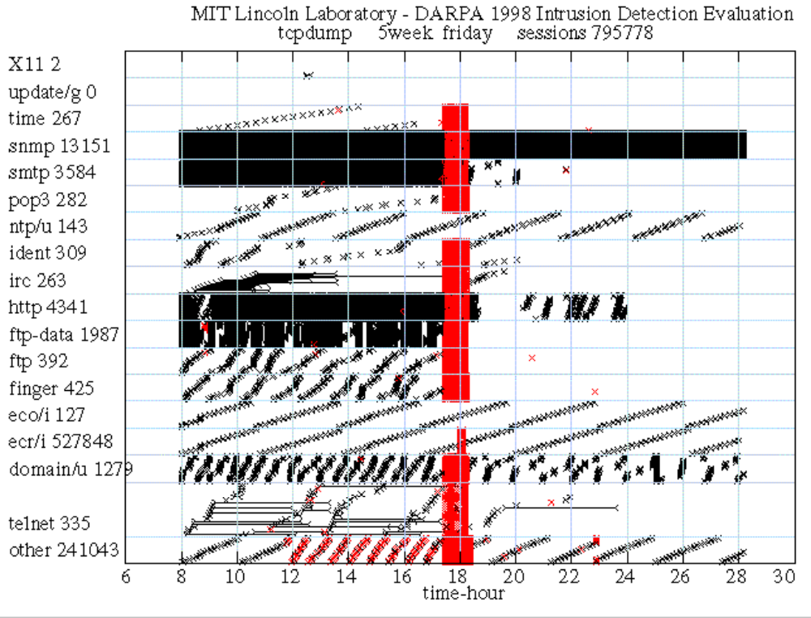
Training Data Traffic, Week 5, Friday
NEPTUNE (synflood)
FORMAT - 1
SMURF
LOADMODULE
ROOTKIT (tftp)
PORT
SWEEP
EJECT
FORMAT - 2
Notes:
This shows a day in the life of the simulation. Every session is represented on the plot as beginning with a “<“ and ending with a “>”. If the sessions continued for a noticeable length of time, these marks are connected with a line. Connections corresponding to attacks are shown in red. Traffic spans numerous different services and continues for the whole 24 hour day. Hundreds of thousands of connections are typically seen per day in the simulation.

Slide 34
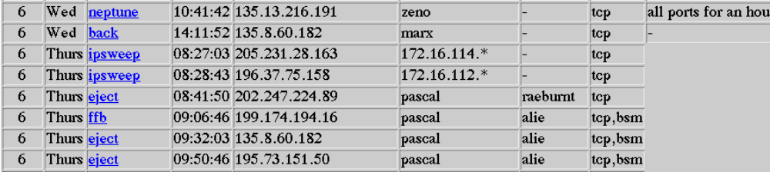
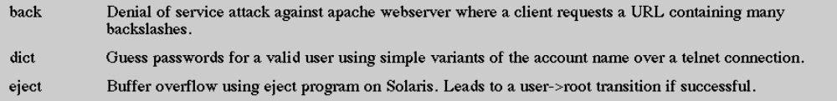
Attack Descriptions on Web Site
All Attacks are Described and Every Instance is Labeled in the Training Data
Notes:
The list of all attacks that were run were posted to our web site. This list contains information about the source and destination machine, the time of the attack, and a brief description of the attack.

Slide 35
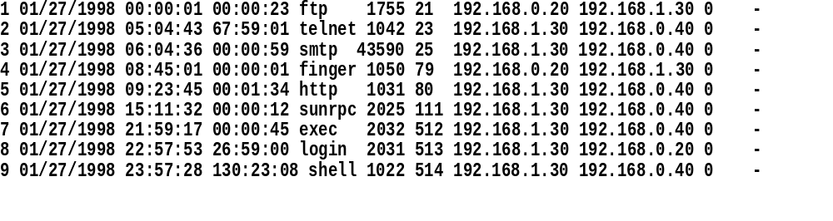
Scoring Based on List Files
Start Start Src Dest Src Dest Attack
# Date Time Duration Serv Port Port IP IP Score Name
Separate List Files for TCPdump and BSM Data
Identify Every Attack and Normal Session
  Every TCP/IP Sessions, Most UDP and ICMP Packets
Attack Score is Set by Intrusion Detection System, Higher Number Indicates Greater Certainty of Attack in Session, Score Set to 0 or 1 Initially for Sample and Training Data
Attack not Counted as Detected Unless Participant Matched it to the Correct List File Entry
Notes:
For each of tcpdump and BSM data, a list file was created which provides a sequential list of every internet connection observable in the data. Each list entry corresponds to one connection and contains the start time, duration, ports, source and destination ip’s of the sessions. It also contains a truth column where the contractor has to fill a score for the likelihood he believes the session corresponds to an attack, and another column for the name of the attack. We generate a truth list file in which the second to last column is a 0 for normal traffic and a 1 for an attack session.

Slide 36
Outline
Overview of 1998 Intrusion Detection Evaluation
Approach to Evaluation
  Examine internet traffic in airforce bases
  Simulate This Traffic on a Simulation network
Background traffic
Attacks
Training and Test Data Description
Participants and Their Tasks

Slide 37
Participant Tasks
INPUT
LIST FILES
SNIFFED
DATA
AUDIT
DATA
ALIGN
DETECTIONS WITH LIST FILE ENTRIES
INTRUSION
DETECTOR
SCORED
LIST FILES
FILE
SYSTEM DUMPS
We Provide Two Weeks of Audit Data (BSM), Sniffed Data (Tcpdump), File System Dumps, and List Files Without Attacks Labeled
Contractors Apply Their Intrusion Detection Systems, Align Outputs to List Files and Return Scored List Files
We Evaluate Performance Using Truth Concerning Attacks
Notes:
Participants score each session of the list files based on the output from their ID systems. We evaluate their performance using truth list files.

Slide 38
Six Participants in 1998 Off-Line Evaluation
Used TCPDump or Both TCPDump and BSM Inputs
  UCSB
  Columbia
  SRI-Emerald (Both TCPDump and BSM Inputs)
  Iowa
Used Only BSM or File System Dumps as Inputs
  UCSB
  RST
  SRI-Derbi (File System Dumps)
Notes:
6 outside sites participated in the off line evaluation. Some sites used only tcpdump data, some used BSM data, and some used both data sets.

Slide 39
System Descriptions
Columbia
  Department of Computer Science Columbia University
  JAM Project
  Prof. Salvatore J. Stolfo
  http://www.cs.columbia.edu/~sal/JAM/PROJECT/recent-results.html
  Our system consists of a set of data mining tools. In the lowest level,
  we extended Bro, a system for filtering and reassembling IP packets, to
  summarize tcpdump data into connection records, each with an extensive
  set of features. Similarly, we developed a program to process BSM data
  into session records. We use association rule and frequent episode
  programs to mine the (pre-processed) audit data for frequent inter- and
  intra- audit record patterns. These patterns are then used for 1) user
  and network service anomaly detection; and 2) guidelines for selecting
  and constructing temporal statistical features into classification
  models. We use RIPPER to learn rules from data that contains labeled
  intrusions. These rules are used for misuse detection.
  Meta-classification is used to learn rules that combine evidence from
  tcpdump and BSM, and misuse and anomaly detection models.
UCSB
  University of California at Santa Barbara
  Prof. Richard A. Kemmerer
  STAT Project
  http://www.cs.ucsb.edu/~kemm/netstat.html/projects.html
  STAT looks for specific attack signatures.
  Signatures range from very specific, matching a single known
  attack, to fairly general, matching a class of attacks. And most of the
  general attacks are parameterized by a number of configuration files,
  which specify, for example, a set of directories that should not be
  written to, and a set of files that should be read only by another
  specified set of programs.
Notes:
The systems used by the different sites ranged from signature detection, to statistical detection, to anomaly detection.

Slide 40
System Descriptions
SRI-EMERALD
  EMERALD Project
  Computer Science Laboratory, SRI International
  Phillip Porras
  http://www2.csl.sri.com/emerald/emerald.html
  We will employ the EMERALD statistical analysis engine (estat) and the EMERALD signature analysis engine (eXpert) to analyze both BSM and TCPdump data streams. EMERALD is a scalable surveillance and response architecture for large distributed networks. The architecture is novel in its use of highly distributed, independently tunable, surveillance and response monitors that are deployed at various abstract layers in the network. EMERALD's analysis scheme is hierarchically layered and extensible, providing a range of security coverage from the localized analysis of key domain services and assets, to coordinated global attacks against multiple domains and network infrastructure. EMERALD targets external threat agents who attempt to subvert or bypass network interfaces and controls to gain unauthorized access to domain resources. In addition, EMERALD provides a framework for correlating the results from its distributed analyses to provide a global detection and response capability to network-wide coordinated attacks.
SRI - DERBI
  DERBI Project
  AI Center, SRI International
  Douglas B. Moran, Senior Computer Scientist
  http://www.ai.sri.com/~derbi/
  DERBI is a prototype computer security tool targeted at diagnosing and recovering from network-based break-ins. Our prototype will interact with the user analyzing the break-in and advising on recovery. The technology adopted has the ability to handle multiple methods (often with different costs) of obtaining desired information, and the ability to work around missing information. The prototype will not be an independent program, but will invoke and coordinate a suite of third-party computer security programs (COTS or public) and utility programs. A critical part of our tool will be the generation of a standardised report and an explanation of what it discovers and its path of reasoning and actions. The explanation will be produced for the user and the report sent to an organization that collects and coordinates security incident reports from a range of sites (eg, CERT, ASSIST).

Slide 41
System Descriptions
IOWA
Secure and Reliable Systems Laboratory, Iowa State University, Computer Science Department
Prof. R. Sekar
http://seclab.cs.iastate.edu/~sekar
The system used for this evaluation focuses on behaviors that can be characterized in terms of sequences of packets received (and transmitted) on one or more network interfaces. This system is also tuned to detect abnormal behaviors that can be associated with appropriate responsive actions. For instance, when our system identifies the presence of unusually high number of packets destined for non existent IP addresses or services, it would respond by dropping the packets before it reaches its destination, rather than attempting to investigate the underlying cause for these packets (such as the use of network surveillance tool such as satan or nmap). This system can directly process the tcpdump data that is being provided for the intrusion detection competition, and hence we are entering this system in the competition.
RST
Reliable Software Technologies,
Dr. Anup Ghosh
http://www.rstcorp.com/~anup/
Our baseline intrusion detection system produces an "anomaly score" on a per session basis. If it finds a session with a non-zero anomaly score, it will warn of possible intrusion. The anomaly score is the ratio
of programs that were determined to exhibit anomalous behavior during the session to the total number of programs executed during the session. Program anomaly is determined by looking at the sequence of bsm events which occurred during all executions of that program. A group of N sequential BSM events is grouped together as an N-gram. During training, a table is made for each program executed during collection of the training data. A table for a program P contains all N-grams which occurred in any execution of P. During classification, an N-gram is considered anomalous if it is not present in the appropriate table. A group of W sequential, overlapping N-grams (where each N-gram is offset from the next N-gram by a single BSM event) is grouped into a window. A window is considered anomalous if the ratio of anomalous N-grams to the total window size is larger than some threshold T_w. A program is considered anomalous if the ratio of anomalous windows to total windows (note that windows do not overlap) is larger than some threshold T_p.

Slide 42
System Descriptions
BASELINE KEYWORD SYSTEM
Analysis Performed by MIT Lincoln Laboratory
This baseline system was included as a reference to compare performance of experimental systems to current practice. This system is similar to many commercial and government intrusion detection systems. It searches for and counts the occurrences of roughly 30 keywords. These keywords include such words and phrases as “passwd”, “login: guest”, “.rhosts”, and “loadmodule” which attempt to find either attacks or actions taken by an attacker after an attack occurs such as downloading a password file or changing a host’s access permissions. It searches for these words in text transcripts made by reassembling packets from byte streams associated with all TCP services including telnet, http, smtp, finger, ftp, and irc. This system provides detection and false alarm rates that are similar to those of military systems such as ASIM and commercial systems such as Net Ranger. In the current DARPA 1998 evaluation, the detection and false alarm rates of this system were very similar to those rates obtained by Air Force Laboratory researchers using one day of our background traffic and additional attacks for real-time evaluations.

Slide 43
Baseline Keyword System
We were Requested to Provide Baseline Results for This System
The Performance of this System is Similar to That of Many Commercial and Government Systems
Used TCPDump Inputs
Searched for the Occurrence of 30 Keywords in TCP Sesssions
Notes:
Lincoln provided a baseline keyword spotting ID system to provide a basis of comparison between the new generation systems and the type of ID system currently used in the military.

